Slide 1
Data Analysis
Brandon Krakowsky

Slide 2
Data Analysis

Slide 3
Loading Data – pandas Module
The pandas module provides data analysis tools
It can connect to and interact with a database
It can also read and write Excel files
It provides a useful read_excel method which reads an Excel file into a DataFrame import pandas as pd df = pd.read_excel(’my_file.xlsx’) #read the file into a DataFrame
A DataFrame is a 2-dimensional labeled data structure
You can think of it like a spreadsheet or database table
For reference:
http://pandas.pydata.org/pandas-docs/stable/generated/pandas.read_excel.html

Slide 4
Loading Data – pandas Module
The pandas module also provides a useful ExcelFile class with a parse method that can read individual sheets in an Excel file import pandas as pd xls = pd.ExcelFile(’my_file.xlsx’) df = xls.parse(’my_sheet’) #read the sheet into a DataFrame
We’ll use this for loading our data
Confirm you’ve downloaded the ‘yelp.xlsx’ file
For reference:
http://pandas.pydata.org/pandas-docs/stable/generated/pandas.ExcelFile.parse.html

Slide 5

Our Data – Yelp Dataset
Information about local businesses in 13 cities in PA and NV
Courtesy Yelp Dataset Challenge (https://www.yelp.com/dataset/)
“yelp_data” tab data columns:
name: Name of business
category_0: 1st user-assigned business category
category_1: 2nd user-assigned business category
take-out: Flag (True/False) indicating if business provides take-out
review_count: Number of reviews
stars: Overall star rating
city_id: Identifier referencing city of business (match to id on “cities” tab)
state_id: Identifier referencing state of business (match to id on “states” tab)

Slide 6
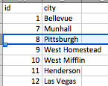
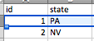
Our Data – Yelp Dataset
“cities” tab data columns:
id: Unique identifier of city
city: City name
“states” tab data columns:
id: Unique identifier of state
state: State name

Slide 7
Loading Data – pandas Module
Let’s load and read the ‘yelp.xlsx’ file
import pandas as pd
xls = pd.ExcelFile('yelp.xlsx')
df = xls.parse('yelp_data') #read the “yelp_data” sheet into a DataFrame
df is a DataFrame type(df)
Get a count of rows len(df)
Get the size (rows, columns) df.shape

Slide 8
Inspecting Data - DataFrame
Get a count of values in each column df.count()
You can look at the column headers by accessing the columns attribute df.columns
And the type of data stored in each column by accessing the dtypes attribute df.dtypes
For reference: http://pandas.pydata.org/pandas-docs/stable/dsintro.html#dataframe

Slide 9
Inspecting Data - DataFrame
Provides various summary statistics for the numerical values in DataFrame df.describe()
Quickly examine the first 5 rows of data df.head()
Or the first 100 rows of data df.head(100)
Drop the duplicates (based on all columns) from df df = df.drop_duplicates()
For reference: http://pandas.pydata.org/pandas-docs/stable/dsintro.html#dataframe

Slide 10
Querying Data
Select just the business names using the “name” of the attribute in between square brackets [] df[”name"] #returns name for every record
Query the location for the first 100 businesses atts = ["name", "city_id", "state_id”] #store the list of attributes in a list df[atts].head(100)
This only shows the id for each city and state
How can we get the actual values?

Slide 11
Joining Data
We need to look up the values in the “cities” sheet and “states” sheet
Then combine them with the data in the “yelp_data” sheet
We do this by joining the datasets using a common field (identifier) in each
Note: This process of joining tables is similar to what we do with tables in a relational database
The city_id in “yelp_data” will join to the id in “cities”
The state_id in “yelp_data” will join to the id in “states”

Slide 12
Joining Data
The most common type of join is called an inner join
Combines DataFrames based on a join key (common identifier)
Returns a new DataFrame that contains only those rows where the value being joined exists in BOTH tables
DataFrame1
DataFrame2

Slide 13
Joining Data
Import the “cities” sheet into it’s own DataFrame using the parse method df_cities = xls.parse('cities’)
The pandas function for performing joins is called merge
Specify the DataFrames to join in the “left” and “right” arguments
Specify inner (the default option) for the “how” argument
Specify the join keys in the “left_on” and “right_on” arguments df = pd.merge(left=df, right=df_cities, how='inner', left_on='city_id', right_on='id’)
What’s the new size (rows, columns) of df? df.shape
Now we can see the cities in df df.head()

Slide 14
Joining Data - Exercise
Import the “states” sheet into it’s own DataFrame
Join (merge) with df
Calculate the new size (rows, columns) of df
Show the name, city, and state for the first 100 businesses

Slide 15
Joining Data - Exercise
Import the “states” sheet into it’s own DataFrame df_states = xls.parse(’states’)
Join (merge) with df df = pd.merge(left=df, right=df_states, how='inner', left_on=’state_id', right_on='id’)
Calculate the new size (rows, columns) of df df.shape
Show the name, city, and state for the first 100 businesses atts = ["name", "city", "state”] #store the list of attributes in a list df[atts].head(100)

Slide 16
Querying Data - Slicing Rows
You can get a slice of a DataFrame by using a colon (:)
Format: [start_index:end_index]
start_index and end_index are both optional
start_index is the index of the first value (included in slice)
end_index is the index of the last value (not included in slice)

Slide 17
Querying Data - Slicing Rows
Get the 2nd 100 businesses listed in the data df[100:200] #returns rows 100 to 199
Get the name of the last business listed in the data last_index = len(df) – 1 last_business = df[last_index:] #returns the last row last_business[“name”] #returns the “name” of the last row
Another way … df[-1:][“name”] #returns the “name” of the last row

Slide 18
Querying Data - Conditions Using Boolean Indexing
To filter a DataFrame using Boolean Indexing, you first create a Series, a one-dimensional array
Each element in the Series has a value of either True or False
Boolean Indexing compares each value in the Series to each record in the DataFrame
For reference: http://pandas.pydata.org/pandas-docs/stable/indexing.html

Slide 19
Querying Data - Conditions Using Boolean Indexing
Select the businesses in Pittsburgh pitts = df["city"] == "Pittsburgh” #creates a Series with True/False values
The type is Series type(pitts)
You can see the True/False values print(pitts)
Filter the elements in df df[pitts] #filters df based on the True/False values in the pitts Series
For reference: http://pandas.pydata.org/pandas-docs/stable/indexing.html

Slide 20
Querying Data - Conditions Using Boolean Indexing
Does the "The Dragon Chinese Cuisine” offer take out? rest = df["name"] == "The Dragon Chinese Cuisine” #creates the series bus = df[rest]["take_out”] #filters the df and returns the “take_out” column
For reference: http://pandas.pydata.org/pandas-docs/stable/indexing.html

Slide 21
Querying Data - Conditions Using Boolean Indexing
Select the bars cat_0_bars = df["category_0"] == "Bars” cat_1_bars = df["category_1"] == "Bars” df[cat_0_bars | cat_1_bars] #returns rows where cat_0_bars is True | (OR) cat_1_bars is True
Select the bars in Carnegie cat_0_bars = df["category_0"] == "Bars” cat_1_bars = df["category_1"] == "Bars” carnegie = df["city"] == "Carnegie” df[(cat_0_bars | cat_1_bars) & carnegie] #returns rows where cat_0_bars is True | (OR) cat_1_bars is True & (AND) carnegie is True
For reference: http://pandas.pydata.org/pandas-docs/stable/indexing.html

Slide 22
Querying Data - Conditions Using Boolean Indexing
Select the bars and restaurants in Carnegie cat_0 = df["category_0"].isin(["Bars", "Restaurants"]) #tests if category_0 is in the provided list cat_1 = df["category_1"].isin(["Bars", "Restaurants"]) #tests if category_1 is in the provided list carnegie = df["city"] == "Carnegie” df[(cat_0 | cat_1) & carnegie] #returns rows where cat_0 is True | (OR) cat_1 is True & (AND) carnegie is True
For reference: http://pandas.pydata.org/pandas-docs/stable/indexing.html

Slide 23
Querying Data - Exercise
How many total dive bars are there in Las Vegas?
Assume a Yelp user assigned “Dive Bars” in the category_0 column or category_1 column
Recommend a random dive bar with at least a 4 star rating
Look at the total set of dive bars above and query for those that have a star rating of at least 4.0
Import the random module: import random
Get a random number using the randint method
Get a random dive bar from the set above using the random number
For reference: https://docs.python.org/3/library/random.html

Slide 24
Querying Data - Exercise
How many total dive bars are there in Las Vegas? #create 3 series from df lv = df["city"] == "Las Vegas” cat_0_bars = df["category_0"] == "Dive Bars” cat_1_bars = df["category_1"] == "Dive Bars” #filter df using 3 series divebars_lv = df[lv & (cat_0_bars | cat_0_bars)] #print length of dive bars in LV (divebars_lv) print("There are", len(divebars_lv), "dive bar(s) in LV”)

Slide 25
Querying Data - Exercise
Recommend a random dive bar with at least a 4 star rating
stars = divebars_lv["stars"] >= 4.0 #create new series from divebars_lv divebars_4rating_lv = divebars_lv[stars] #filter divebars_lv import random #import random module #get random number between (but including) 0 and last index rand_int = random.randint(0, len(divebars_4rating_lv) – 1) #get random dive bar based on random number rand_divebar = divebars_4rating_lv[rand_int:rand_int + 1] #another way, is by using the iloc method to choose rows (and/or columns) by position #rand_divebar = divebars_4rating_lv.iloc[rand_int, :] #show random dive bar with at least 4 star rating rand_divebar
For reference: https://docs.python.org/3/library/random.html

Slide 26
Computations – sum()
Calculate the total (sum) number of reviews for nail salons in Henderson cat_0 = df["category_0"].str.contains("Nail Salon”) #tests if category_0 string value contains “Nail Salon” cat_1 = df["category_1"].str.contains("Nail Salon”) #tests if category_1 string value contains “Nail Salon” henderson = df["city"] == "Henderson” df[(cat_0 | cat_1) & henderson]["review_count"].sum() #returns the total “review_count” value for the rows where cat_0 is True | (OR) cat_1 is True & (AND) henderson is True
For reference: http://pandas.pydata.org/pandas-docs/stable/api.html#api-dataframe-stats

Slide 27
Computations – mean()
Calculate the average (mean) star rating for auto repair shops in Pittsburg? cat_0 = df["category_0"].str.contains("Auto Repair”) cat_1 = df["category_1”].str.contains("Auto Repair”) pitts = df["city"] == 'Pittsburgh’ df[(cat_0 | cat_1) & pitts]["stars"].mean() #returns the average “stars” value for the rows where cat_0 is True | (OR) cat_1 is True & (AND) pitts is True
For reference: http://pandas.pydata.org/pandas-docs/stable/api.html#api-dataframe-stats

Slide 28
Other Methods
What cities are in our dataset? df["city"].unique() #returns the unique values in city
How many businesses are there in each city? df['city'].value_counts() #counts the records for each city
How many unique user assigned business categories are there in category_0? df['category_0'].nunique() #counts the non-null unique values in category_0
For reference: http://pandas.pydata.org/pandas-docs/stable/api.html#api-dataframe-stats

Slide 29
Updating & Creating Data
You can easily create new columns in DataFrames by just naming and using them
Example: my_df[”new_column”] = <some_value>
Add a new “categories” column that combines “category_0” and “category_1” as a comma-separated list df["categories"] = df["category_0"].str.cat(df["category_1"], sep=',’) #concatenates the string value of category_0 with category_1, separated by a ‘,’
Now we can look up businesses based on the single “categories” column! df[df["categories"].str.contains("Pizza")]

Slide 30
Updating & Creating Data - Exercise
Add a new “rating” column that converts “stars” to a comparable value in the 10-point system df["rating"] = df["stars"] * 2
Now, update the new “rating” column so that it displays the rating as ”x out of 10”
First, create a helper function that will take a rating value as an argument and concatenate a string to it def convert_to_rating(x): return (str(x) + " out of 10") #casts x (rating) to a string, then concatenates another string
Second, use the apply() method to run the helper function for the rating in each row df["rating"] = df[”rating"].apply(convert_to_rating) #applies function
df.head()

Slide 31
Querying Data - Summarizing Groups
groupby splits data into different groups based on variable(s) of your choice
Note: This process of grouping data is similar to what we do with Group By in SQL
groupby returns a GroupBy object, which provides a dictionary whose keys are the computed unique groups and corresponding values
When we group by “city”, the keys will be all possible cities df.groupby(['city']).groups.keys()
We can use the groups attribute to get a specific group of records. How many businesses in Las Vegas? len(df.groupby([‘city']).groups[’Las Vegas’])
But this isn’t super useful!
We really want to be able to perform aggregate computations on the data in each group

Slide 32
Querying Data – agg()
The agg() method performs aggregate computations on the data in each group
You can pass a list of aggregate functions as arguments
Use methods from NumPy, a popular package for scientific computing (http://www.numpy.org/)
Let’s find out the sum, mean, and standard deviation for the star ratings of each city import numpy as np df.groupby(['city']).agg([np.sum, np.mean, np.std])["stars"]

Slide 33
Pivot Tables

Slide 34
Pivot Tables – Using index
A pivot table is a useful data summarization tool that creates a new table from the contents in the DataFrame
In order to pivot the DataFrame, we need at least one index column, to group by
The index is just like the variable(s) you group by in the groupby method
The pivot table will provide useful summaries along that index, such as summation or average

Slide 35
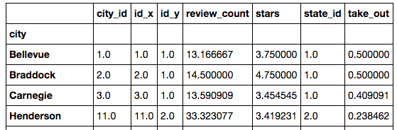
Pivot Tables – Using index
Let’s use city as the index pivot_city = pd.pivot_table(df,index=["city"]) pivot_city
The type of pivot_city is still a DataFrame type(pivot_city)
Note: By default, the pivot table calculates average (mean) for each column

Slide 36
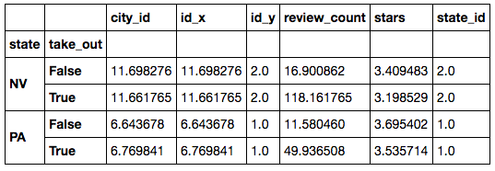
Pivot Tables – Using index
It is also possible to use more than one index (indices)
The pivot table will sort the data for you
Use indices “state” and “take_out”
pivot_state_take = pd.pivot_table(df,index=["state", ”take_out"])
pivot_state_take
The cells display the average (mean) values for each ”take_out” value in each “state”

Slide 37
Pivot Tables - Exercise
Create a pivot table that displays the average (mean) review count and star rating for bars and restaurants in each city (only use category_0 for simplicity)
Hints:
Filter for “Bars” and “Restaurants”
Pivot on state, city, and category_0
#Make a dataframe that only contains bars and restaurants
rest = df["category_0"].isin(["Bars", "Restaurants"])
df_rest = df[rest]
#Pivot along state, city, and category_0
pivot_state_cat = pd.pivot_table(df_rest,index=["state", "city", "category_0"])
#Bonus: since the pivot table is also a dataframe, we can filter the columns
pivot_state_cat[["review_count", "stars"]]

Slide 38
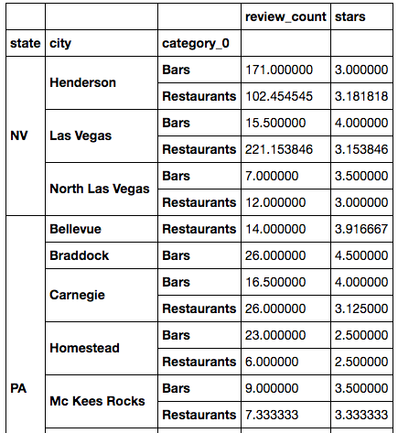
Pivot Tables - Exercise
Since the pivot table shows the average (mean) value by default, we now have a new table of average review count and star ratings for each city.

Slide 39
Pivot Tables – aggfunc()
To display summary statistics other than the average (mean)
Use the aggfunc parameter to specify the aggregation function(s)
Use the values parameter to specify the column(s) for the aggfunc
As before, use the aggregation methods from the NumPy package
In our dataset, how many (sum) reviews does each city have?
import numpy as np pivot_agg = pd.pivot_table( df,index=["state", "city"], values=["review_count"], #Specify the column(s) for the aggfunc aggfunc=[np.sum] #Specify the aggregation function(s)
) pivot_agg

Slide 40
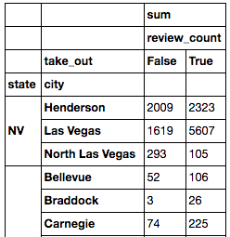
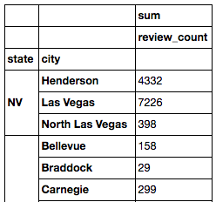
Pivot Tables – aggfunc()
It’s possible to further segment our results using the “columns” parameter pivot_a2 = pd.pivot_table( df,index=["state", "city"], values=["review_count"], #Specify the columns to separate the results columns=["take_out"],
aggfunc=[np.sum]
)
pivot_a2

Slide 41
Pivot Tables – aggfunc()
We can also pass as an argument to aggfunc(), a dict object containing different aggregate functions to perform on different values
If we want to see the total number of review counts and average ratings pivot_agg3 = pd.pivot_table( df,index=["state", "city"], columns=["take_out"], aggfunc={"review_count":np.sum, "stars":np.mean} #Let’s use np.sum for review_count and np.mean for stars
)
pivot_agg3

Slide 42
Visualization

Slide 43
Jupyter Notebook – “Magic Functions”
Jupyter Notebook (iPython) has built-in “magic functions” that are helpful for handling “meta” (other) functionalities in Python
The magic function “%pylab inline” allows the PyLab library to load and lets our visualizations show up inside our notebook
Run this:
%pylab inline

Slide 44
Visualization - matplotlib
matplotlib is a popular plotting library for Python, which is included in the PyLab package
It’s a very powerful tool that can plot a large variety of figures (and even animate them)
Examples covered:
Histograms: Represents the distribution of values in the data
Scatterplots: Displays a set of data points (observations) for 2 variables (bivariate), in an x-y plane
Documentation for pyplot: http://matplotlib.org/api/pyplot_api.html

Slide 45
Visualization - Histogram
How do review patterns differ across different cities? Which city has a higher number of 5 star reviews or 1 star reviews, Pittsburgh or Las Vegas?
Let’s find out by plotting a histogram that compares the distribution of rating scores between businesses in Pittsburgh and Las Vegas
This can be done in two steps:
Prepare the data: create appropriate DataFrame or Series
Plot: set various options for pyplot

Slide 46
Visualization - Histogram
How do review patterns differ across different cities? Which city has a higher number of 5 star reviews or 1 star reviews, Pittsburgh or Las Vegas?
Let’s find out by plotting a histogram that compares the distribution of rating scores between businesses in Pittsburgh and Las Vegas
This can be done in two steps:
Prepare the data: create appropriate DataFrame or Series
Plot: set various options for pyplot
Step 0: import
#Import pyplot
import matplotlib.pyplot as plt

Slide 47
Visualization - Histogram
Step 1: data prep #Create new dataframes for each city
df_pitt = df[df["city"] == 'Pittsburgh']
df_vegas = df[df["city"] == 'Las Vegas']
df_vegas
#Extract the ”stars” column into series
series_vegas = df_vegas["stars"]
series_pitt = df_pitt["stars"]
series_vegas
Now we are ready to plot!

Slide 48
Visualization - Histogram
Step 2: Let’s place a histogram for the Pittsburgh business ratings plt.hist(
series_pitt, #star ratings for Pittsburgh
alpha=0.3, #transparency
color='yellow', #histogram color
label='Pittsburgh', #label
bins=‘auto’ #sets the bins (dividers for the x-axis automatically
) plt.show() #show the plot

Slide 49
Visualization - Histogram
Add another histogram for Las Vegas
# Same as before, but with red
plt.hist(series_vegas, alpha=0.3, color='red', label='Vegas’, bins=‘auto’)
Now we have two histograms inside our plot!
Note: Always make sure to re-run the plt.show() method
plt.show() #show the plot
Let’s add more features to our plot

Slide 50
Visualization - Histogram
We can add labels for our x and y axes plt.xlabel('Rating') # x-axis represents each rating score plt.ylabel(’Number of Rating Scores') # y-axis represents the number rating scores
Add a legend plt.legend(loc='best') #Location for legend: ‘best’ lets PyPlot decide where to place the legend
Add a title plt.title("Review distribution of Pittsburgh and Las Vegas")

Slide 51
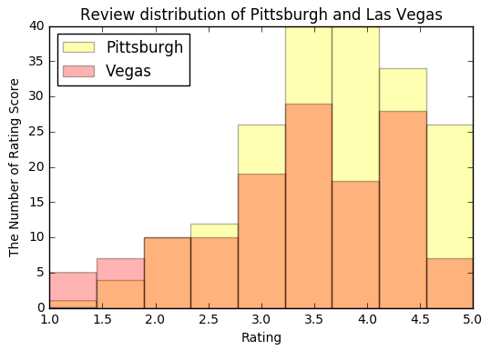
Visualization - Histogram
When everything is set, we run plt.show() to display our work!
plt.show()
Try tweaking the parameters to adjust the plot to your preference
The “orange” portion represents the overlap between Pittsburgh and Las Vegas

Slide 52
Visualization - Histogram
Having two plots overlap doesn’t seem very appealing. Let’s place the histogram bars side by side using lists
This time, we only have one histogram object with a list of values plt.hist([series_pitt, series_vegas], alpha=0.7, color=['red','blue'], label=['Pittsburgh','Las Vegas’],bins="auto") plt.xlabel('Rating’) plt.ylabel('Number of Rating Scores’) plt.legend(loc='best’) plt.title("Review distribution of Pittsburgh and Las Vegas”) plt.show()

Slide 53
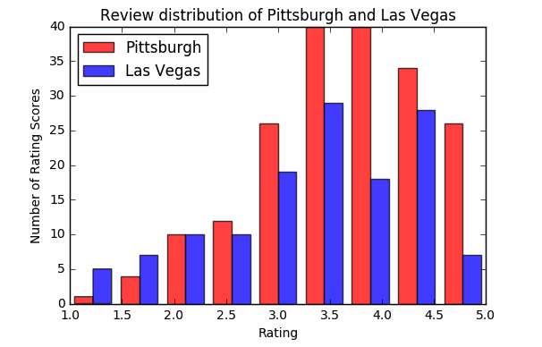
Visualization - Histogram

Slide 54
Visualization - Scatterplot
Scatterplot displays a set of data points (observations) for 2 variables (bivariate), in an x-y plane
We can use scatterplot to compare multiple categories on two different dimensions
This time, let’s visualize the review counts and star ratings for businesses in the following categories: ‘Health & Medical’, ‘Fast Food’, ‘Breakfast & Brunch’
# Creating new dataframes for each category
df_health = df[df["category_0"] == 'Health & Medical']
df_fast = df[df["category_0"] == 'Fast Food']
df_brunch = df[df["category_0"] == 'Breakfast & Brunch']

Slide 55
Visualization - Scatterplot
We can place a scatterplot object in the plot using plt.scatter()
# The first two arguments are the data for the x and y axis, respectively
plt.scatter(df_health['stars'], df_health['review_count'],
marker='o', #marker shape
color='r', #color: red
alpha=0.7, #alpha (tranparency) s = 124, #size of each marker label=['Health & Medical'] #label
)

Slide 56
Visualization - Scatterplot
Place two more scatterplot objects within the plot
# The first two arguments are the data for the x and y axis, respectively
plt.scatter( df_fast['stars'], df_fast['review_count'],
marker='h’,
color='b’, alpha=0.7,
s = 124,
label=['Fast Food']
)
plt.scatter(df_brunch['stars'],df_brunch['review_count'],
marker=‘^',
color='g',
alpha=0.7,
s = 124,
label=['Breakfast & Brunch']
)

Slide 57
Visualization - Scatterplot
Add the axis labels and the legend
plt.xlabel('Rating’)
plt.ylabel('Review Count’)
plt.legend(loc='upper left’)
Show the plot! plt.show()

Slide 58
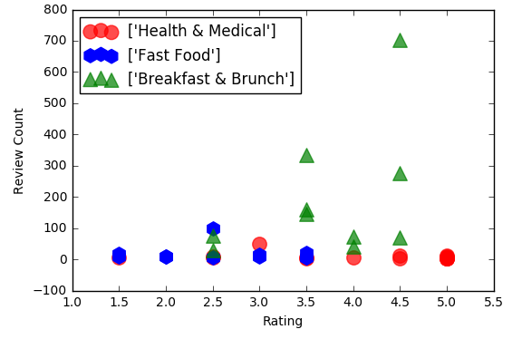
Visualization - Scatterplot
We now have a visualization of review count and star rating for each category.
Each marker represents a single business. We can observe some clustering in review count and star rating, depending on the categories.

Slide 59
Visualization - Scatterplot
The outliers in the y axis (review_count) are squashing the other data points
Let’s make a little tweak to represent the y-axis in a logarithmic scale, so that review count is displayed in an order of magnitude (groups of 10)
All the values will be visualized in a more manageable range
Get the axes attribute from pyplot to define the scale of each axis
axes = plt.gca() # get current axes
axes.set_yscale('log') # set the scale of the y-axis as logarithmic
plt.show()

Slide 60
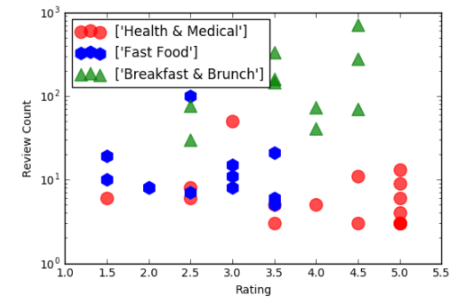
Visualization - Scatterplot
Looks much better!

Slide 61
For Reference: Seaborn
Seaborn is a Python data visualization library based on matplotlib
It provides a high-level interface for drawing more attractive and informative statistical graphics
It can also be used to enhance matplotlib graphics
More info: https://seaborn.pydata.org/

